Slide 2


Our Motto
“It is the quality of
our people,
and their capacity to deliver solutions that fit, with you and for you, that drive real
business results.”

Slide 3

FS SBU
Notes:
And, for a quick look back – here’s a view of the FS SBU’s history within Capgemini [play video]
[How to embed the video to play full screen on click:
Add video file to same folder as this PPT
On menu ribbon click insert >video on my PC.
Once video is inserted (select it) click on menu ribbon click Playback
Start: play in sequence
Play full screen
Hide while not playing]

Slide 4

Capgemini covers the full spectrum of Financial Services
BANKING
INSURANCE
Retail Banking
Property & Casualty Insurance
Commercial Banking
& Diversified Lending
Life & Annuity Insurance
Health
Insurance
Cards & Payments
61,000 professionals serving FS clients worldwide
Capital Markets & Wealth Management
Consulting ● Technology ● Outsourcing
Notes:
Please note: 61,000 professionals are serving FS clients across GBLs, CC, etc.
Of these, 35,000+ FS professionals are in the FS SBU
The remaining are in the horizontals such as Business Services, I&D, CC etc.

Slide 5
Capgemini’s Financial Services: Innovating to build enterprises of the future
FS Advantage
Our Clients
9
of the top
15 banks
12
of the top 15 investment
banks
12
of the top 15 insurance
companies
Trusted by top clients
‘Partner of the future’ with 45% services in the ‘new’ & ‘next’
Strong domain focus
Insurance – P&C, Life, Health
Banking – Retail, Commercial, Cards & Payments, Capital Markets & Wealth Management
Full spectrum of capabilities
8
of the top 15 asset finance
companies
9
of the top 10 consumer finance companies
Leader in traditional and new age-services
End-to-end problem solving with strong partner ecosystem
Capabilities span: Invent, Shape, Build, Run
Collaborative Business Experience
Doing it ‘with’ our clients, not ‘to or for’ our clients
Outcome-aligned, flexible engagement models
Solid delivery-at-scale track record
Thought-leadership with World Reports
Well-researched World Reports published annually in FS; covered by top media
World Retail Banking Report, World Payments Report, World Wealth Reports, World FinTech Report, World Insurance Report, World InsurTech Report
Notes:
The top companies are based on Global Fortune 2000 list for 2018, as well as other online ranking lists.

Slide 6


























Top wins, across client needs
Transformation
Mega
RPA/Robotics
Cloud/Digital
Notes:
Historically, FS has a great track record and has led the charge with solid performance in H1 – evident in some of the wins highlighted here. We had strong performance in H2 2017 so we need to be vigilant to go beyond this benchmark. This is where the LEAD construct will really come in to play to boost our performance so that we can get ahead of the market. Keep focused on winning those big deals as they will tip the needle in our favor. We’re coming out of the summer holiday months refreshed and this momentum should keep evolving to drive progress across the board.
Transformation:
Orange Bank Leading French Telco launches exciting new All Digital Bank
Metromile Revolutionizing car insurance with Pay-per-mile insurance model
Goldman Sachs ‘Marcus’ created to help people manage dept
DBS ‘Digibank’ in Indonesia
Generali First blockchain-based solution for corporate insurance in Italy
Crédit Agricole Digital banking platform for wealth managers & private banks
Direct Line Group
5-year deal with one of UK’s largest motor and home insurers to transform their technology services
Royal Bank of Canada
A large three-year win to help lead the transformation efforts at RBC’s Wealth Management and Retail lines of business
ANZ
Digital Experience Transformation
Mega:
MetLife Multi-million-euro Infra managed services deal
Discover 3-year extension
Wawanesa System integration
De Lage Landen (DLL) Multi-million-euro renewal
Synchrony Financial
A multi-year managed services deal to transform the application management
TransUnion
Helping TransUnion setup an Innovation Center in India, and will be the Digital and Innovation partner for the client
RPA/Robotics:
CHUBB Collaboration with BSv for FNOL: WorkFusion RPA w/Machine Learning
Barclays Training & enablement services on Blue Prism/support for automation use cases
BNP Paribas Automate contact center Cards/Admin processes on Blue Prism
Kemper Establishes an RPA practice/expands footprint
Nationwide Building Society Automating Underwriting process w/Pega Robotics
Cloud/Digital:
Zurich Multi-million euro AD&M: Transforming applications/cloud migration
AXA Asia Digital & agile transformation
Assurant Cloud-native transformation
Lord Abbett
Onboarding their cloud journey with Amazon Web Services (AWS)
Blue Harvest
ABM AMRO Cloud-based real estate investment app + API
ING Frontend modernization for Credit/Debit Cards
NN
Client profiler algorithm
Policy migration
Chatbox strategy w/SF

Slide 7


















Popular thought-leadership FS Reports
for over two decades
Quoted
in
World FinTech Report
World InsurTech Report
World Insurance Report
World Wealth Reports
World Payments Report
World Retail Banking Report

Slide 8
Our Priorities
L ead through innovative Portfolio
E ngage with energized People
A mplify our audacious Brand
D elight our demanding Clients

Slide 9
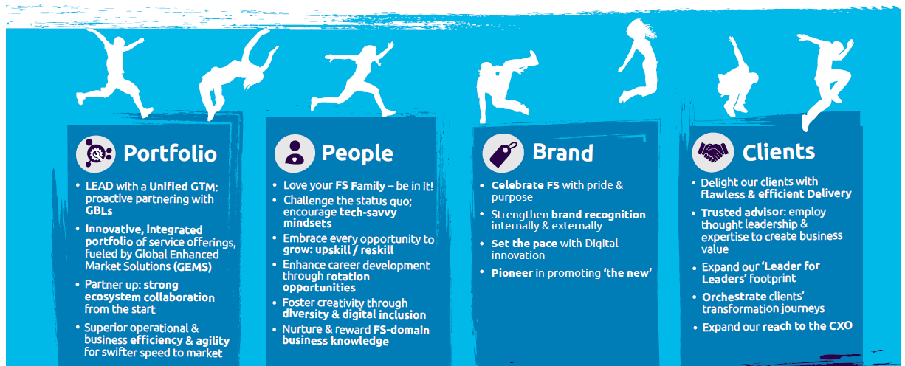
Our Priorities

Slide 10
The FS SBU leadership at a glance (2019)
Anirban Bose
Tangi Le Noc
Global FS SBU CEO
Program Manager
Nilesh Vaidya
Ian Campos
Abhaya Gupta
Kartik Ramakrishnan
Christophe Bonnard
Shane Cassidy
Ritesh Talapatra
Banking Practice Head
Insurance Practice Head
Technology Practice Head
BCM
BU Head
Cont. Europe
BU Head
Insurance
BU Head
Global FS COO /
APAC BU Head
Aruna Padmanabhan
Shobha Meera
Amit Choudhary
Jorge Sobrino Gomez
Lambert Swillens
Deepak Nangia
FS Chief HR Officer
FS GSO & Head, Global Sales & Marketing
/ Communication
Global FS CFO
COO CE
Head of Delivery
Head of Australia
Ashish Patharkar
Shinichi Tonomura
Claire Sauvanaud
Izzy Franco
Kelly Jones
Head of India
operation
Head of Asia
Global Account Management Leader
Big Deals / Transformation
Head of Legal
Sudhir Pai
GBL Leaders
Global FS CTIO
Vincent Charpiot
Pierre-Louis Seguin
Stanislas de Roys
Ramana Bhandaru
CIS FS Leader
BSv FS Leader
Invent FS Leader
I&D FS Leader
GBL Leaders
Direct report
Doted report

Slide 11

Banking & Capital Markets Business Unit (BCM BU)
Kartik Ramakrishnan
BCM BU
BCM BU
Nitin Sharma
Deepa Adhia
Babu Mauze
Raj Lanka
Allen Gilbert
Ajit Mahale
BU Finance
Sales Officer
MU 1
Canada
MDE & Alliances
Delivery Complex
Projects
Delivery
MU3 & MU6
Delivery MU
1, 2, 3, 4 & 5
Soumya Ghosh
Roopa Bhandarkar
P V Narayan
MU1
Canada
MU2
Morgan Stanley
MU3
US Banking
Som S Royyuru
Ashish Devalekar
Sankar Krishnan
GBL Leaders
MU4
Barclays
MU5 HSBC
MU6
New Business
Sameer Ahluwalia
Stan de Roys Kristofer le Sage
Michael Malloni Craig Mill
Arindam Choudhury
Delivery Complex Projects
BSv GBL
Invent GBL
CIS GBL
I&D SPOC
GBL Leaders
FS

Slide 12
Insurance Organization BU
Shane Cassidy
Satish Weber
Head, Insurance BU
Sales
Shabrish Menon
Akash Khandelwal
Chad Hersh
Seth Rachlin
Tim Dwyer
John Walters
Delivery
Finance
Life
MU1
MU2
MU3
Tom Meyer
TBD
Becky Rao
Vijay Amballa
James Kruger
Supply Chain & Operations
People Care
Health
Prashant Shastri
Vijay Amballa
Prashant Shastri
MU4
MU5
MU6
Practices heads
Krishnamurthy Voora
Ian Campos
Shiva Balasubramaniyan (NA)
Ajay Walgude (UK)
ADM
Insurance
Test
GBL Leaders
Anup Kumar
Anup Kumar
Mike Malloni (NA) Craig Mill (UK)
Nate Root
Keith Gage (NA)
- Kris Le Sage de Fontenay (UK)
Vikrant Karnik
Business Services
Cloud Infrastructure Services
Insights & Data
Invent
CFS
GBL’s

Slide 13
The FS World is divided into what we call Practices
Banking Diversified Financials (BDF)
Capital Markets (CM)
Application Development Management (ADM) – ERP also included
Testing
Insurance (Ins)
Global Lead – Carlos Salta
NA Lead – Michael Donnary
NA HR – Michael Nardi
NA Staffing – Heerr Jashnani
Global Lead – Ferreol DeNauris
NA Lead – Peter Katsos
NA HR – Michael Nardi
NA Staffing – Heerr Jashnani
Global Lead – Abhaya Gupta
NA Lead – Ravi Gandla
NA HR – Bill Grish
NA Staffing – Sakti Dash
Global Lead – Abhaya Gupta
NA Lead – Kumar Balasubramanian
NA HR – Margo Sanders
NA Staffing – Swapna Nair
Global Lead – Ian Campos
NA Lead – Andrew Hood
NA HR – Pijush Chatterjee
NA Staffing – Dinesh Nigam

Slide 14
The FS World is divided into what we call Practices (continued)
Insights & Data (I&D)
Digital (DGTL)
Cards & Payments
Business & IT Transformation - Banking (B&ITT)
Business & IT Transformation - Insurance (B&ITT)
Global Lead – Ramana Bhandaru
NA Lead – Vaibhav Shringarpure
NA HR – Jane Viegas
NA Staffing – Mayuri Chande
Global Lead – Vikrant Karnick
NA Lead – Rene Claudio
NA HR – Carolina Ortiz
NA Staffing – Sakti Dash
Global Lead – Jeroen Holscher
NA Lead – Lakshmanan Sundaram
NA HR – Jane Viegas
NA Staffing – Heerr Jashnani
Global Lead – Nilesh Vaidya
NA Lead – Eric Anklesaria
NA HR – Michael Nardi
NA Staffing – Heerr Jashnani
Global Lead – Nilesh Vaidya
NA Lead – Andrew Hood
NA HR – Pijush Chatterjee
NA Staffing – Dinesh Nigam

